Slide 1

Linux Club @ UMD
Linux Distro Into: Which one to install for new users?

Slide 2
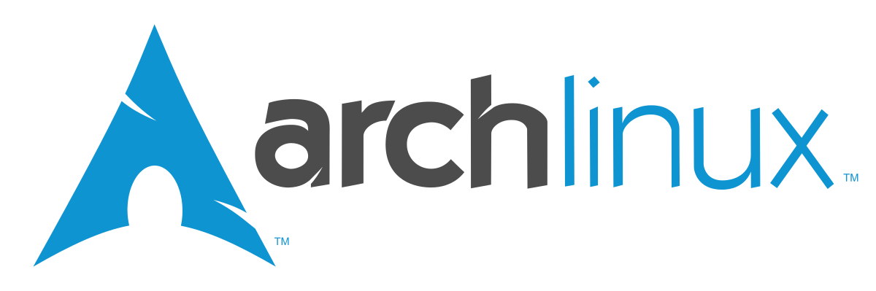
Rolling releases, bleeding edge updates.
  Newest kernel, latest hardware support
More customization, DIY
Pacman package manager, more packages with AUR.

Slide 3
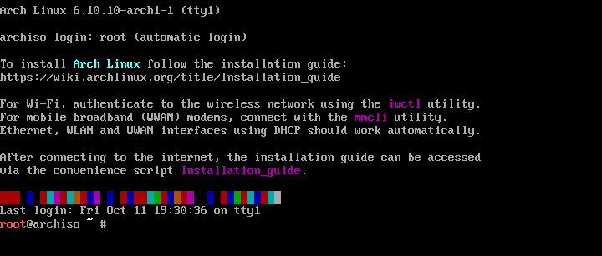
Arch install Part One

Slide 4
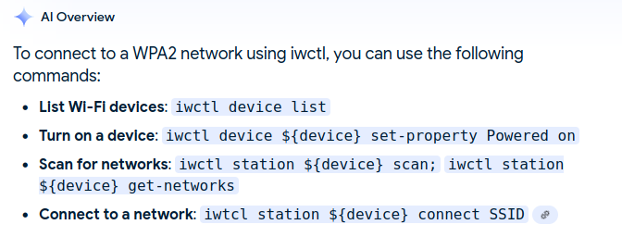
Arch install Part 2

Slide 5
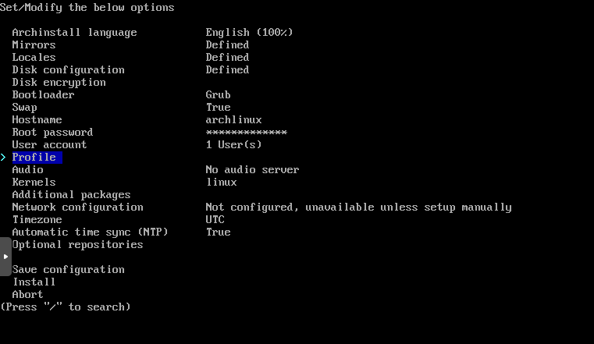
Arch install Part 3

Slide 6
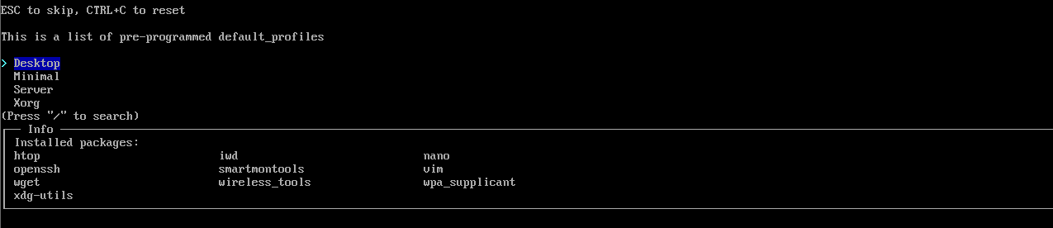
Arch install Part 4

Slide 7
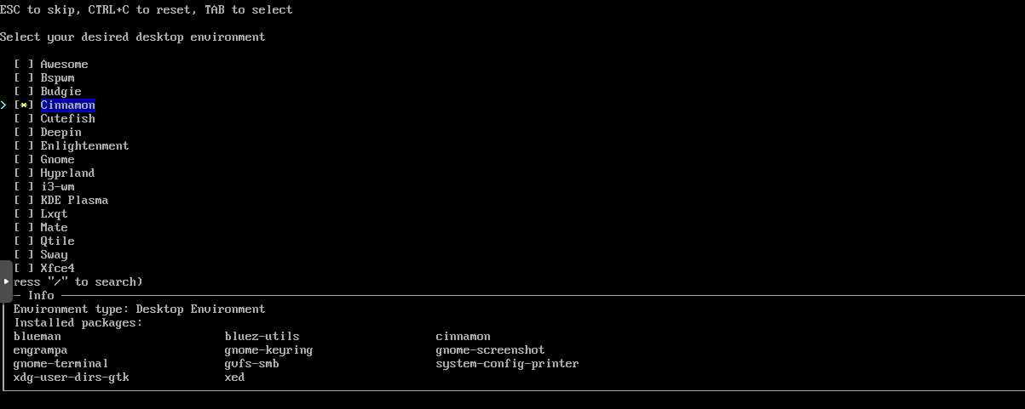
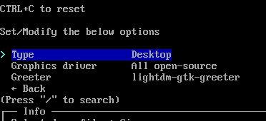
Arch install Part 5

Slide 8
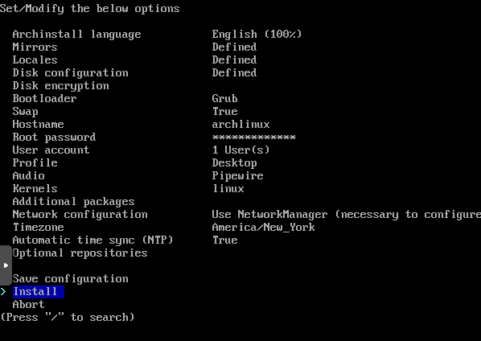
Arch install Part 6
Overall thoughts:
+Can install many Des
+Still relatively easy
-Have to actually choose options, default options are not usable
+Fast install, only a few minutes
If absolutely new to linux will probably have to follow a youtube video.

Slide 9
Using Arch, Installing packages
Official mirrors
By default, arch comes with a lot less packages than the other distros. For example, I had no libreoffice so to install install libreoffice I ran pacman -S libreoffice-still
Upgrade packages: pacman -Syu
Install packages pacman -S name
Search for package: packman -Ss serach
Remove package: pacman -R name
Install local package pacman -U name.pkg.tar.xz

Slide 10
Using Arch User Repository
Many niche open source packages available in AUR.
May not be stable, they may break
You’ll need an AUR helper like yay: https://github.com/Jguer/yay

Slide 11
Arch distros
Use Arch – Best support available, the Arch wiki btw can be used for many distros when trying to understand packages
Endeavour os – Makes life easier with some sane front end tools for pacman installed
Manjaro, default LXDE install with more packages

Slide 12

Major releases every 6 months
More corporate support, used for
developing of RHEL
New software, but stable, major releases but still tons of updates
Fedora Server ISO, Fedora Workstation Gnome ISO, Fedora Workstation KDE ISO
Comes with lots of preinstalled packages

Slide 13
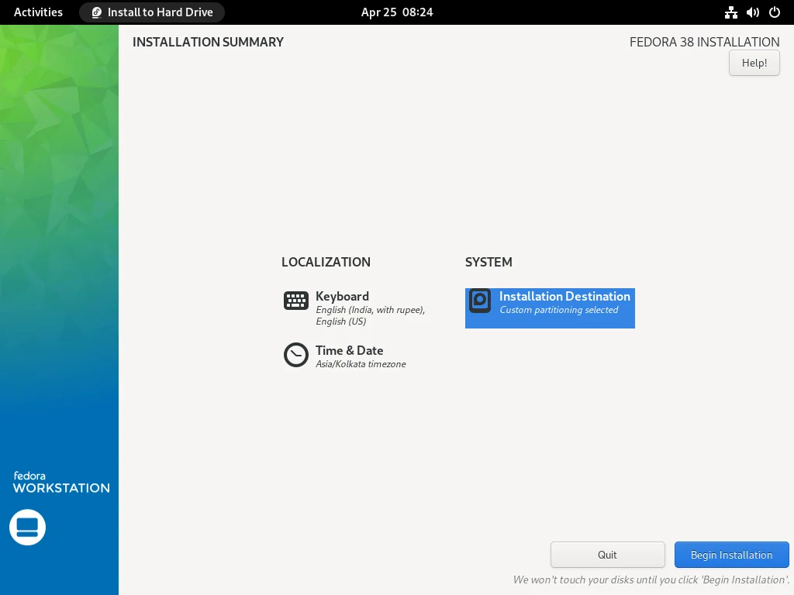
Fedora Install
Download either Gnome or KDE install
Extremely easy, GUI based. Just choose disk and user configuration, it just works.
Install is slow

Slide 14

Using DNF
dnf install package
dnf remove package, dnf autoremove
dnf search
dnf list installed
dnf update, dnf check-update

Slide 15
Add repository
dnf config-manager --add-repo /etc/yum.repos.d/fedora_extras.repo
dnf config-manager --set-enabled repository
System upgrade to new release:
dnf system-upgrade download –releasever=40
dnf system-upgrade reboot
You’ll be doing this every 6 months!

Slide 16
The impact of Fedora
Learning Fedora is useful for systems administration in corporate world.
Amazon uses fedora server
Most companies use Red Hat Enterprise Linux, which is based on Fedora Linux

Slide 17

One of the first distros for Linux from 1993.
Uses APT for frontend package manager
Releases every 2 years, each release supported for 5 years. Less updates, things are stable and don’t change or break. Older software a couple years old in features.
Used in servers and workstations
By far the most amount of packages in
the official repo

Slide 18
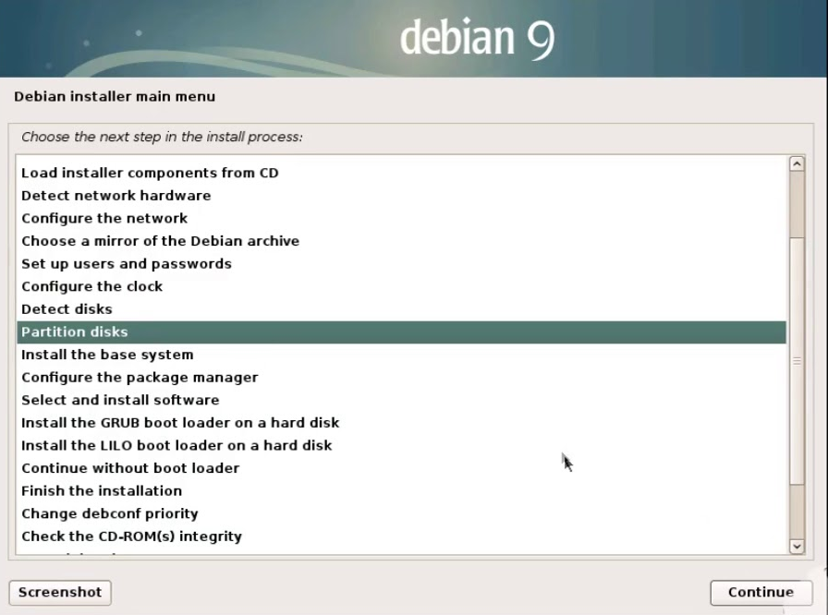
Debian install
Gui based, as flexible as Arch. Usable defaults.
10 minutes

Slide 19
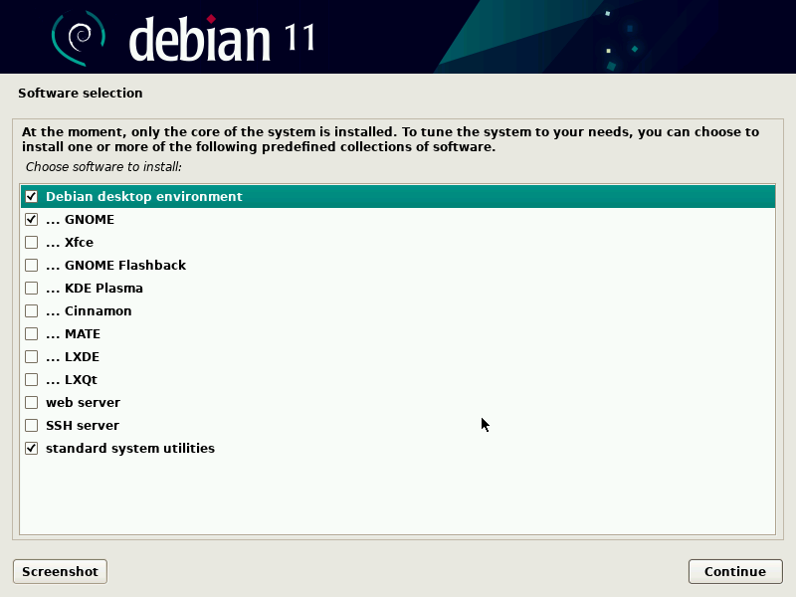
DE Install

Slide 20
Using apt
apt install name
apt remove name, apt autoremove, apt purge name
apt search name, apt list –installed
apt update, apt upgrade
sudo not install by default, either install sudo or change into root user.
Repositories are added to / etc / apt / sources.list.d /, though default repository has lots of packages (but outdated).
Can you debian testing or sid for newer packages

Slide 21
Debian forks
Ubuntu – More commercial support, custom DE theme
Linux mint – Don’t install, just install cinnamon DE on debian
Raspbian – the version of debian for raspberry pi

Slide 22
Which to choose?
New hardware: Use Arch or Fedora
Slow computer: Use Debian or Arch
Easy to use out of the box: Fedora, Debian with default GNOME or KDE DE
Up to date packages: Fedora, Arch
Stability: Debian 1st, then Fedora, Arch is NOT stable.
“Set it and forget it”: Debian*
Commercial and proprietary software support: Debian and Fedora
Customization: Arch and Debian

