Slide 1
Linux Club @ UMD
Privacy and security tools on Linux

Slide 2
LUKS2
Encryption of volumes for linux partition
Typically encrypt /, while /boot is unencrypted (Use Secure Boot to secure /boot)
Use password for encryption, uses hash of password to get AES encryption keys
Data is AES encrypted
Easy to set up when installing your linux system, most distros have this option installer, difficult to setup once you are installed (will need to clone partitions, use recovery system).
Protects your data if someone gains physical access to your computer

Slide 3
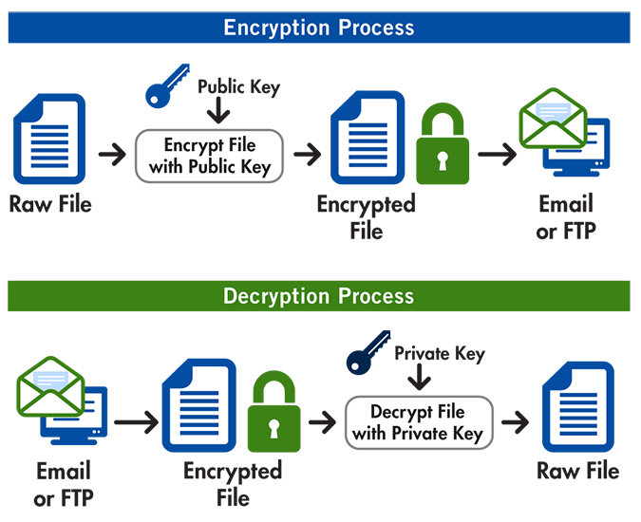
GNU Privacy Guard
Encrypts files, emails, and other data using public-key cryptography.
Encrypt files using AES with password:
gpg --symmetric --cipher-algo AES256 filename
gpg --decrypt filename.gpg > decrypted_filename
Verify signed files with RSA:
gpg --verify file.txt.sig file.txt
gpg --full-generate-key
gpg --import public.key
gpg --armor --detach-sign filename
gpg --armor --export your_email@example.com > publickey.asc
Encrypt and Decrypt files with RSA (PGP Protocol):
gpg --encrypt --recipient recipient-email@example.com message.txt
gpg --decrypt message.txt.gpg

Slide 4
Checksums: sha256sum, md5sum
Verify integrity of files with sha256sum, additionally use check the signature on files or their sum

Slide 5
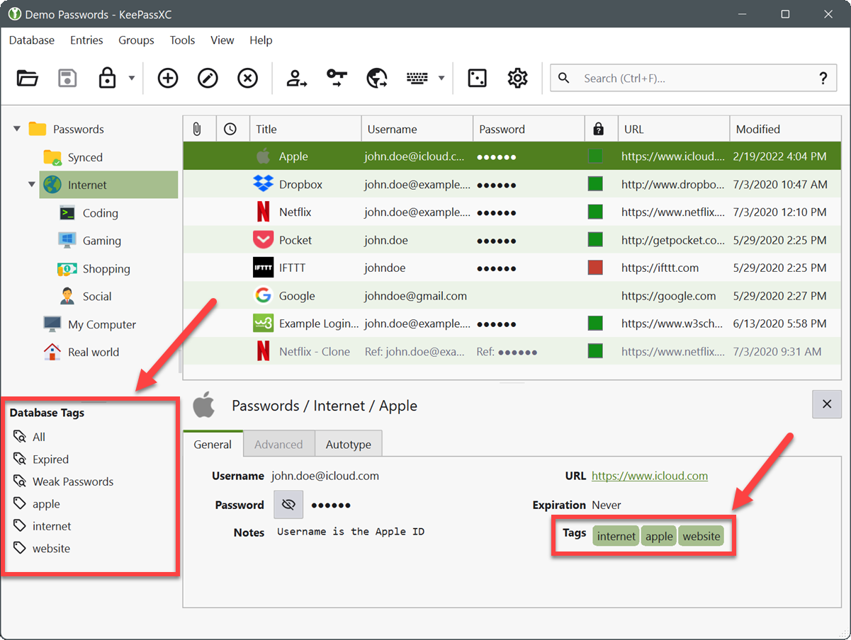
Keepassxc: Password Managers

Slide 6
Metadata removal and file deletion
MAT2 - Metadata remover
Shred - Securely remove files from filesystem
BleachBit - Securely remove files from filesystem
Some modern file systems will still have your data even if you delete it

Slide 7
VPNs
Secure network interface between computers.
Remotely access network
Bypass restrictions and secure internet traffic to trusted VPN server.

Slide 8
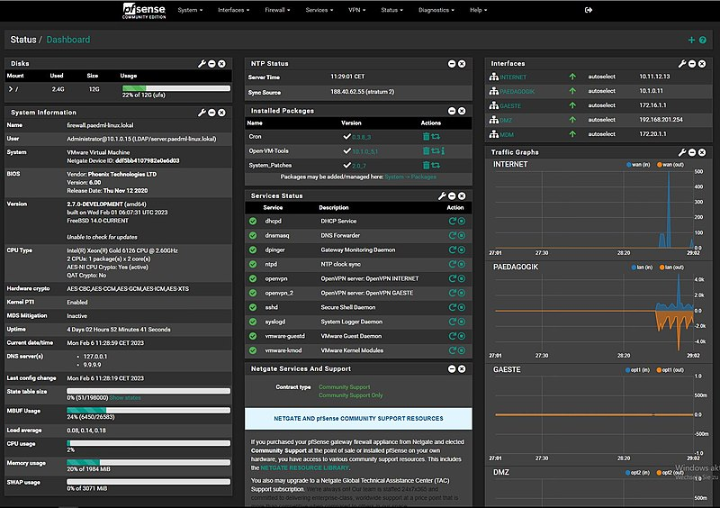
Firewalls
Uncomplicated Firewall
Firewalld
Your router for your home network

Slide 9
OpenSSH
Secure access to other computers on network and internet via user login
Ideally use RSA or ed25519 keys, not password login
Can also forward traffic, such as port forwarding

Slide 10
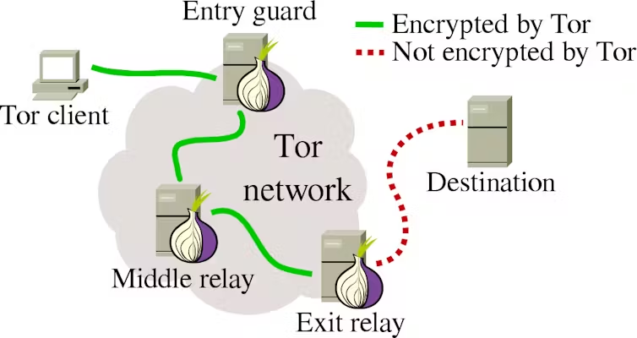
Tor
Community drive anonymous routing protocol
Can be used to anonymously access clearnet, or access other tor network clients - Dark Web

Slide 11
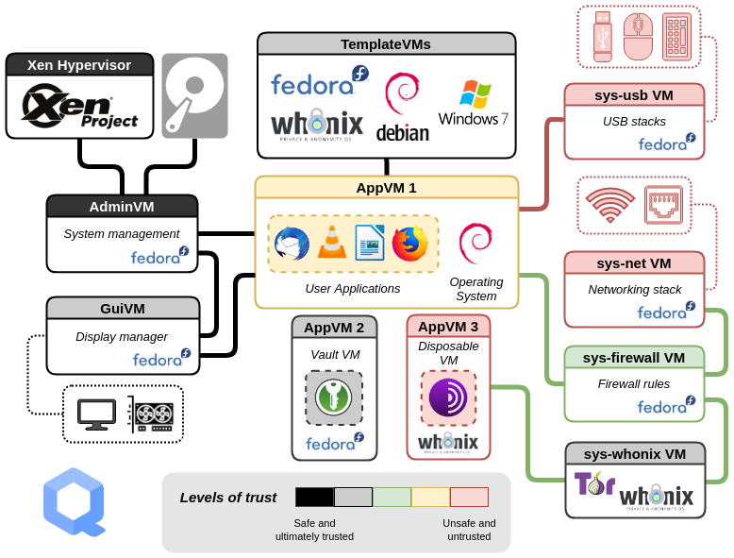
Security OS

Slide 12
Web Browsing

Slide 13
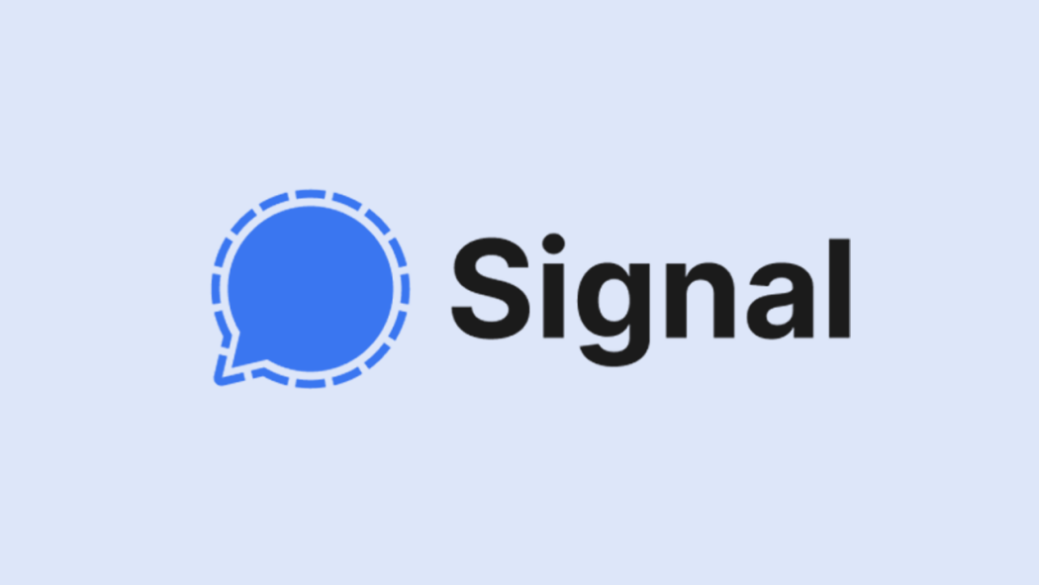
Secure Communication
Host your own email server, or use a privacy focused provider, use PGP

Slide 14
Cryptocurrency
If you need your transactions to be private…..

