Slide 1
Linux Raid
Jack Doggett - Linux Club @ UMD

Slide 2
What is raid
RAID, or Redundant Array of Independent Disks, is a storage technology that combines multiple physical hard drives into a single logical unit. RAID can improve data performance, protection, or both.
Useful in servers and network attached storage
Reliability
Performance
Increased storage

Slide 3
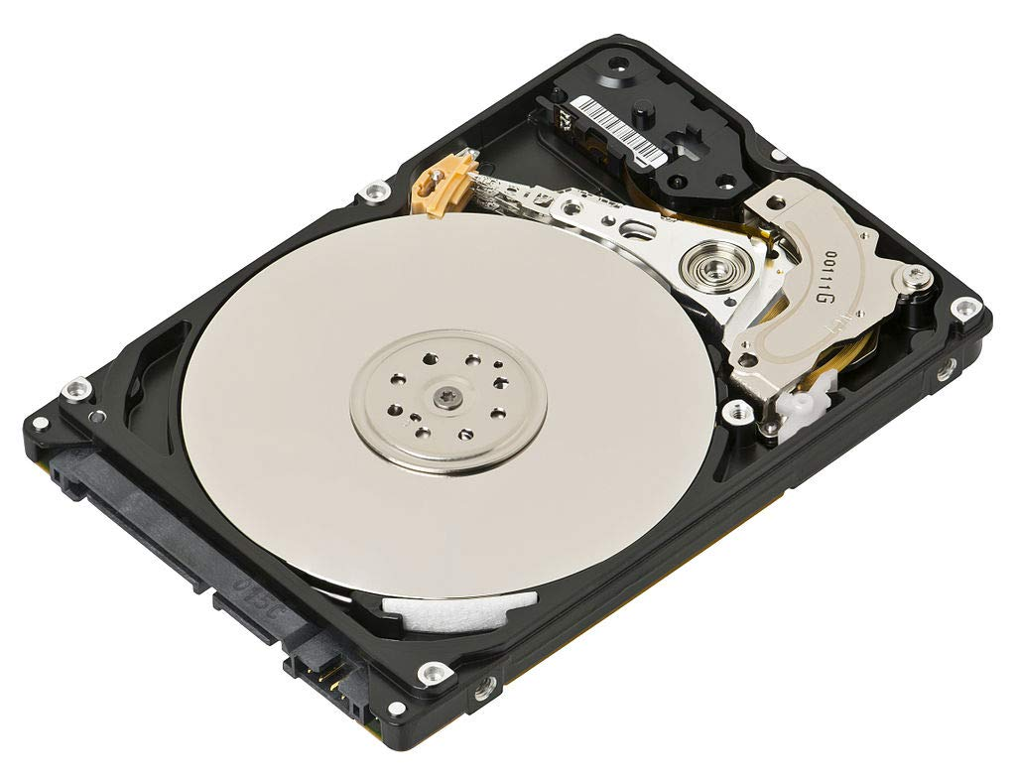
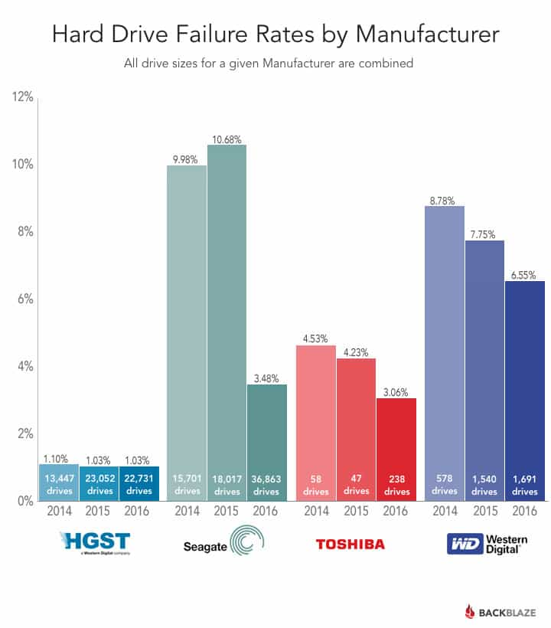
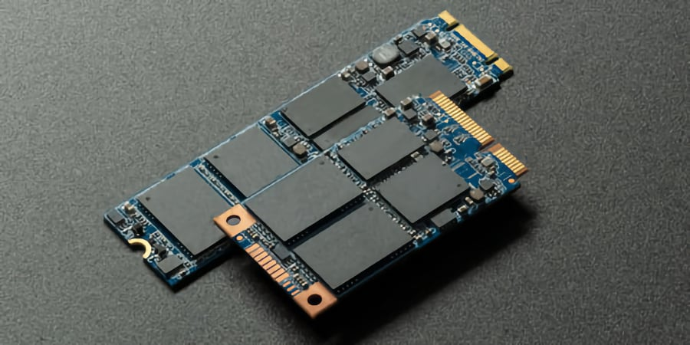
Disks fail!

Slide 4
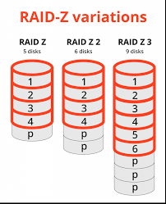
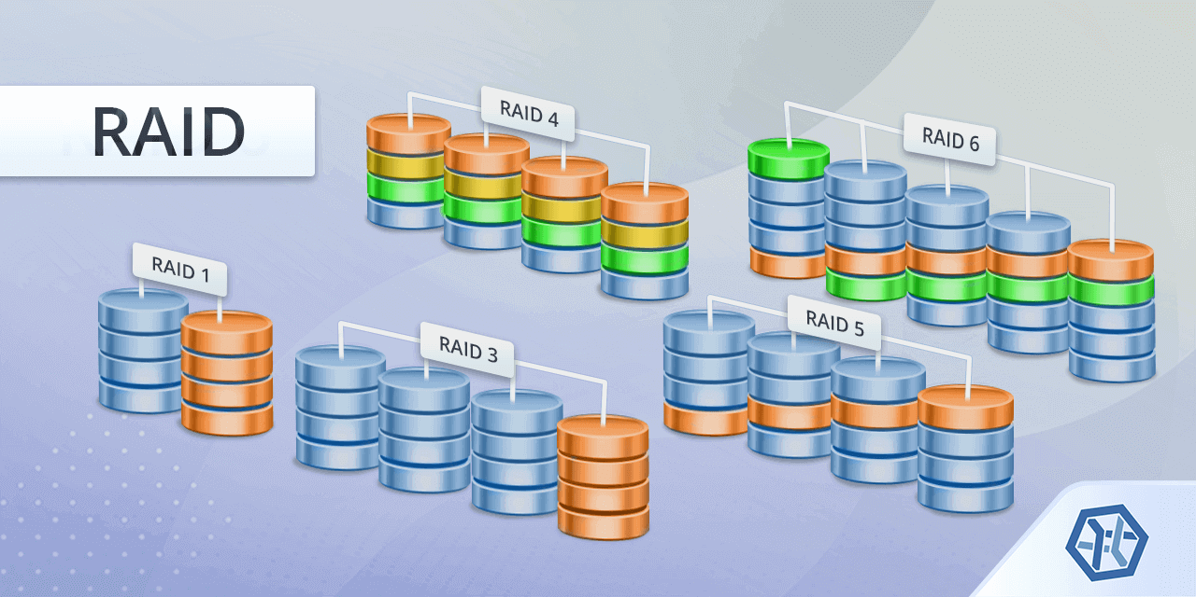
Raid levels

Slide 5
Multiple Device driver - mdadm
A kernel module (md) that provides RAID functionality by managing multiple physical devices as a single logical device.
Supports various RAID levels such as RAID 0, 1, 5, 6, 10, and more. Can replace disks that have gone bad.
Mdadm: the user-space utility for creating, managing, and monitoring MD devices.
mdadm --create: Create a new RAID array
mdadm --assemble: Assemble existing arrays on boot
mdadm --monitor: Monitor the health of the RAID array
mdadm --detail: Provide detailed information about an array
Create RAID1: mdadm --create /dev/md0 --level=1 --raid-devices=2 /dev/sd[b-c]
mdadm --detail –scan >> /etc/mdadm/mdadm.conf
Use lsblk to view block devices
Create single mdX block device, use normal filesystem like EXT4 on top.

Slide 6
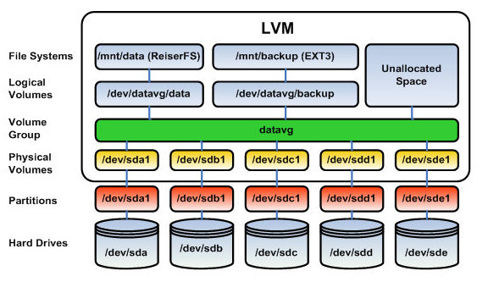
Logical Volume Manager

Slide 7
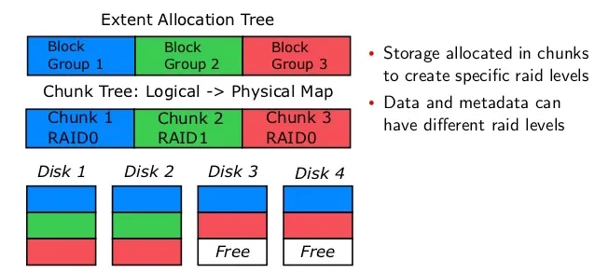
BTRFS - “butterfs” - betterfs
Combined filesystem and volume manager
RAID used to be sus on BTRFS, now simpler raid modes are stable, parity raid on btrfs is still not stable

Slide 8
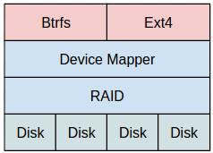
BTRFS raid kinda sucks
Even synology doesn’t trust it!

Slide 9
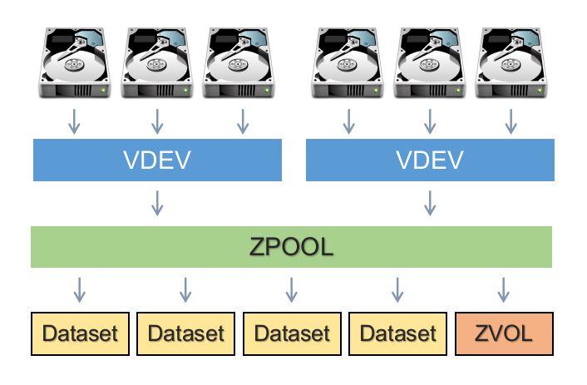
ZFS

Slide 10
